Slide 1
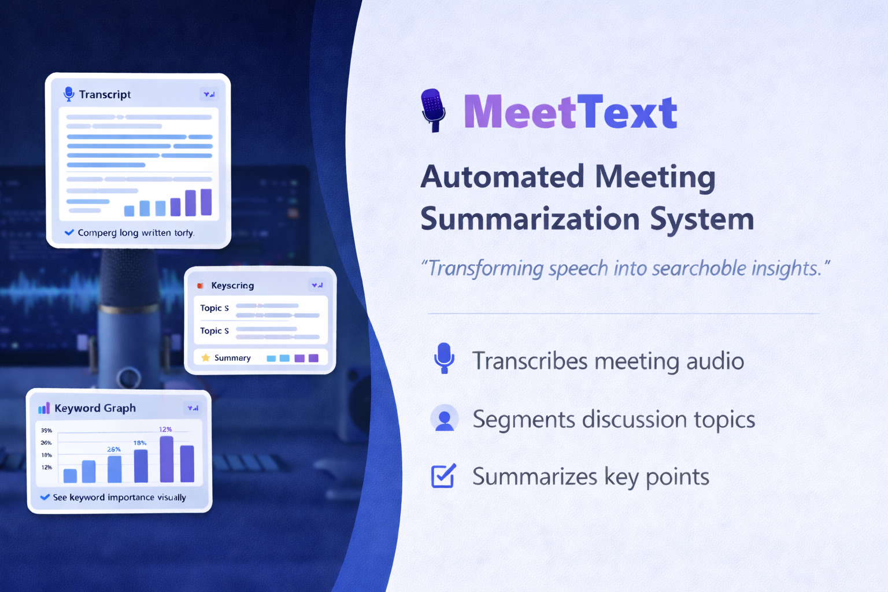
PRESENTED BY
KOWSALYA S

Slide 2


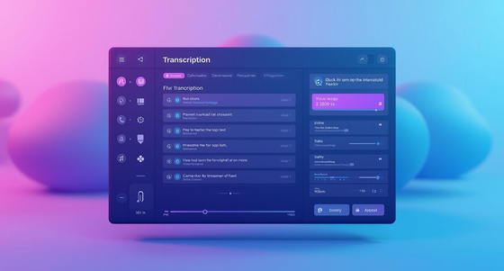
Problem Statement
In modern organizations, meetings play a crucial role in decision-making and collaboration. However, important discussions are often lost due to the absence of accurate documentation. Manual note-taking is time-consuming, error-prone, and distracts participants from active engagement. Existing transcription solutions may lack proper structuring, topic segmentation, or actionable insights, making it difficult to review meetings efficiently.
Hence, there is a need for an automated system that can accurately transcribe meeting audio, summarize key points, and organize discussions into meaningful segments.

Slide 3
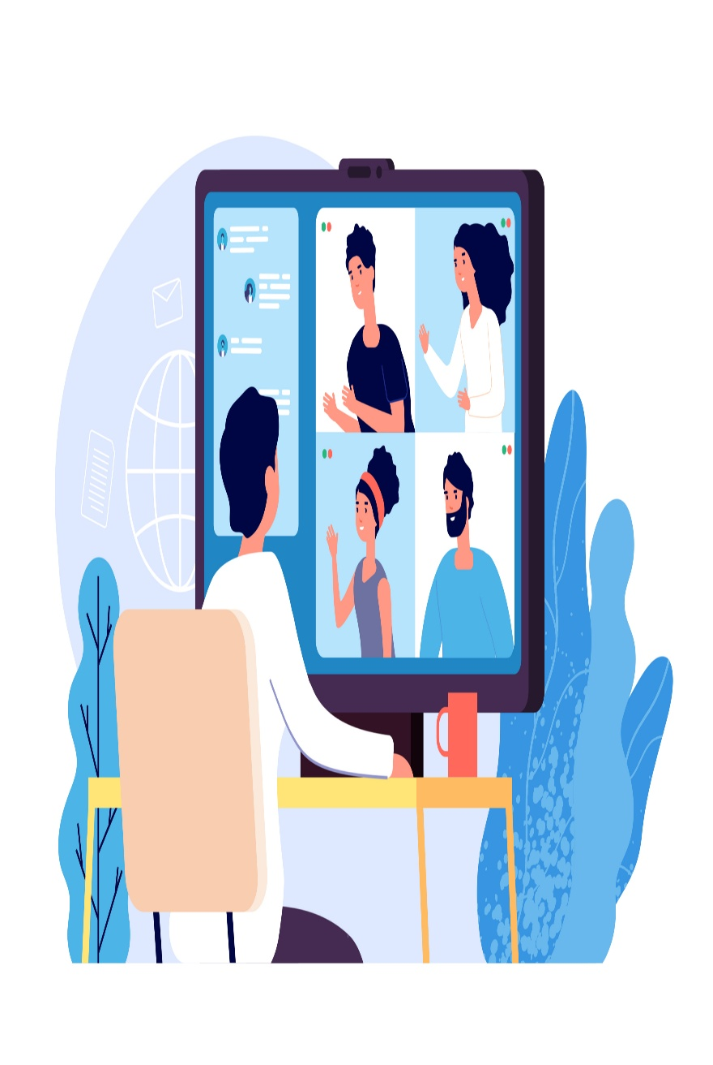
Project solution and Overview
MeetText provides an automated solution to convert meeting audio into accurate text transcriptions and meaningful summaries. It eliminates the need for manual note-taking by capturing spoken content, organizing it into structured text, and presenting key discussion points in an easy-to-understand format. This helps users quickly review meetings and extract important insights.
Project Overview
Captures recorded business meeting audio
Converts speech into accurate text using speech-to-text processing
Segments discussions into meaningful topics
Displays transcription and insights through a simple web interface
Helps users save time and improve meeting productivity

Slide 4
Project Objectives
Convert spoken meeting content into written text
Generate concise summaries and extracts key insights
Support knowledge sharing by making meeting content easier to revisit and share with others.
Identify and separate different discussion topics
Provide a user-friendly interface for navigating the contents

Slide 5
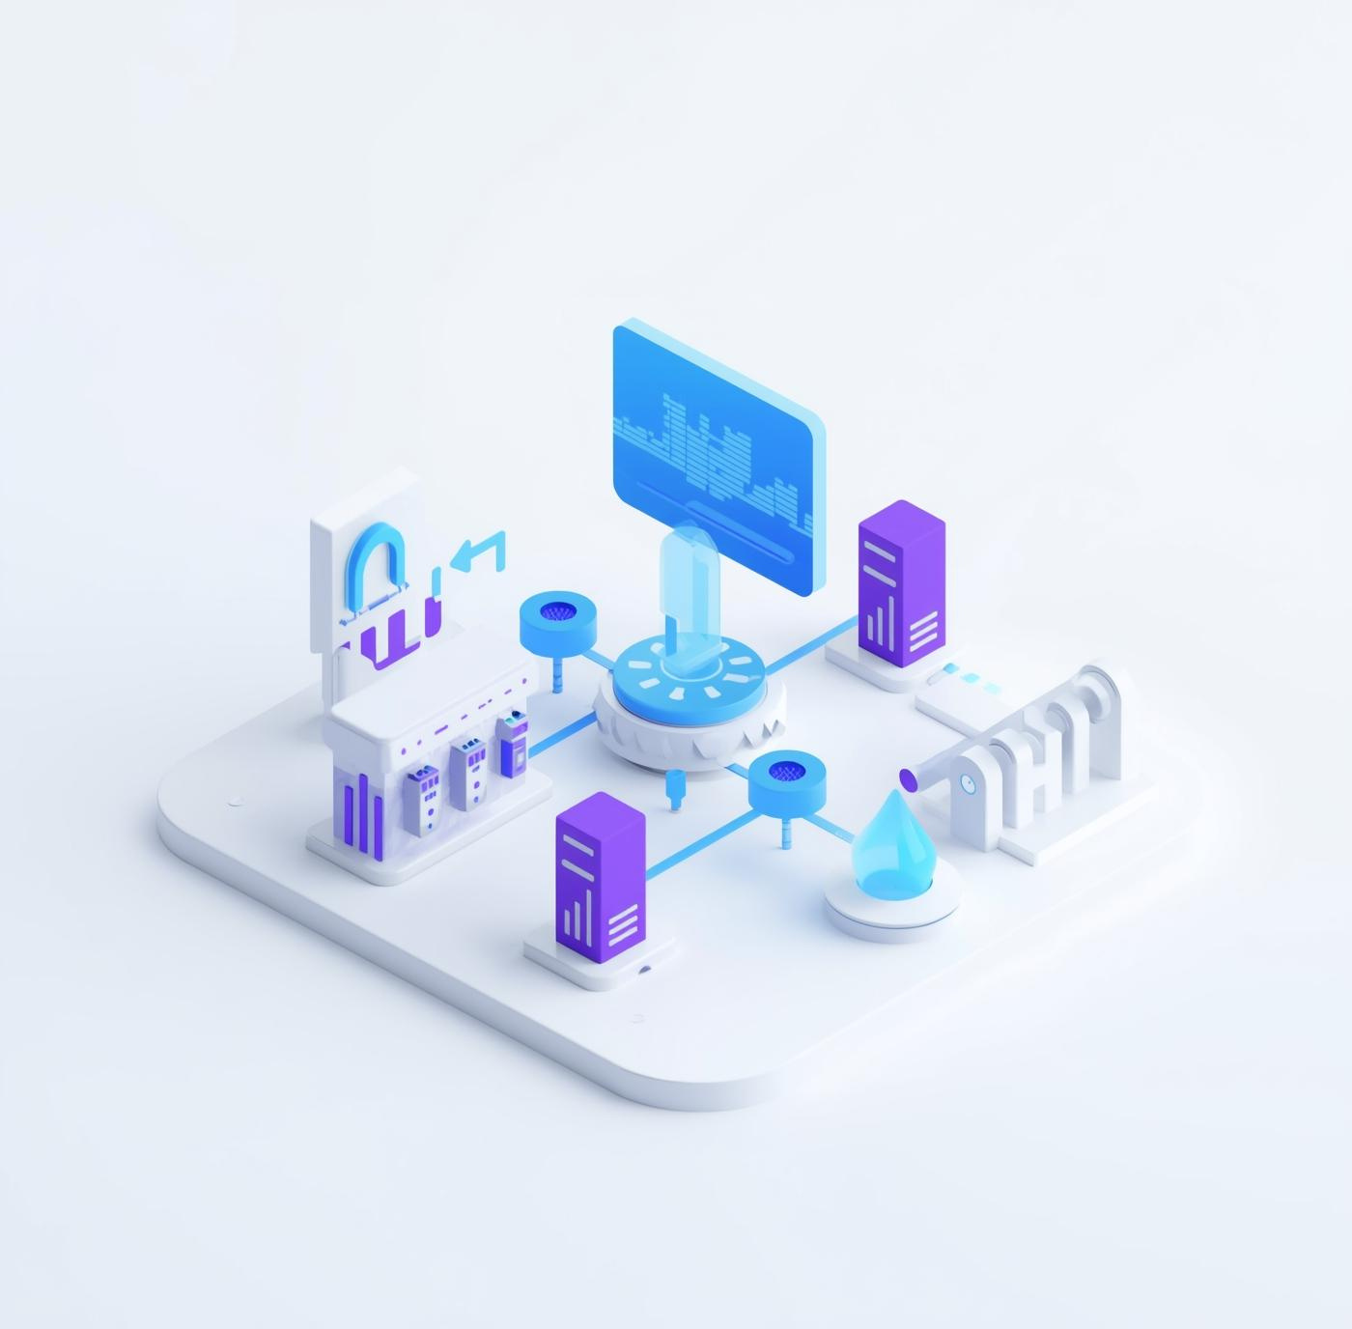
System Architecture
Audio Input
↓
Speech-to-Text (Faster Whisper)
↓
Text Preprocessing & NLP (Segmentation + Summarization)
↓
Output Rendering in Web UI
The system processes audio locally, extracts speech as text, segments topics using NLP techniques then summarizes and visualizes the result in a minimal web interface.

Slide 6
Technologies
Audio Transcription -Faster Whisper (local ASR model)
Backend
Python, Flask
Frontend
HTML, CSS, JavaScript
NLP- Sentence Tokenization, TextTiling, KeyBERT
Visualization
Chart.js or custom keyword bar graphs
Summarization - Extractive summary generation ( BERT-based)

Slide 7

Usage of UI
UI
The user interface (UI) for MeetText was designed to ensure a smooth, intuitive experience while interacting with complex audio analysis It includes:
A homepage to explain the system’s purpose and invite users to start processing their audio.
An upload module for selecting or dragging-and-dropping audio files easily.
A summary and transcription screen, displaying generated text, keyword cloud, and segmented timestamps.
An analytics dashboard with keyword graphs and sentiment insights to make meeting content more actionable.
The UI was styled in a soft pink-purple theme to reflect a calm, modern workspace, combining functionality with approachability. It was created using clean layouts, responsive components, and animated visuals to enhance user engagement

Slide 8
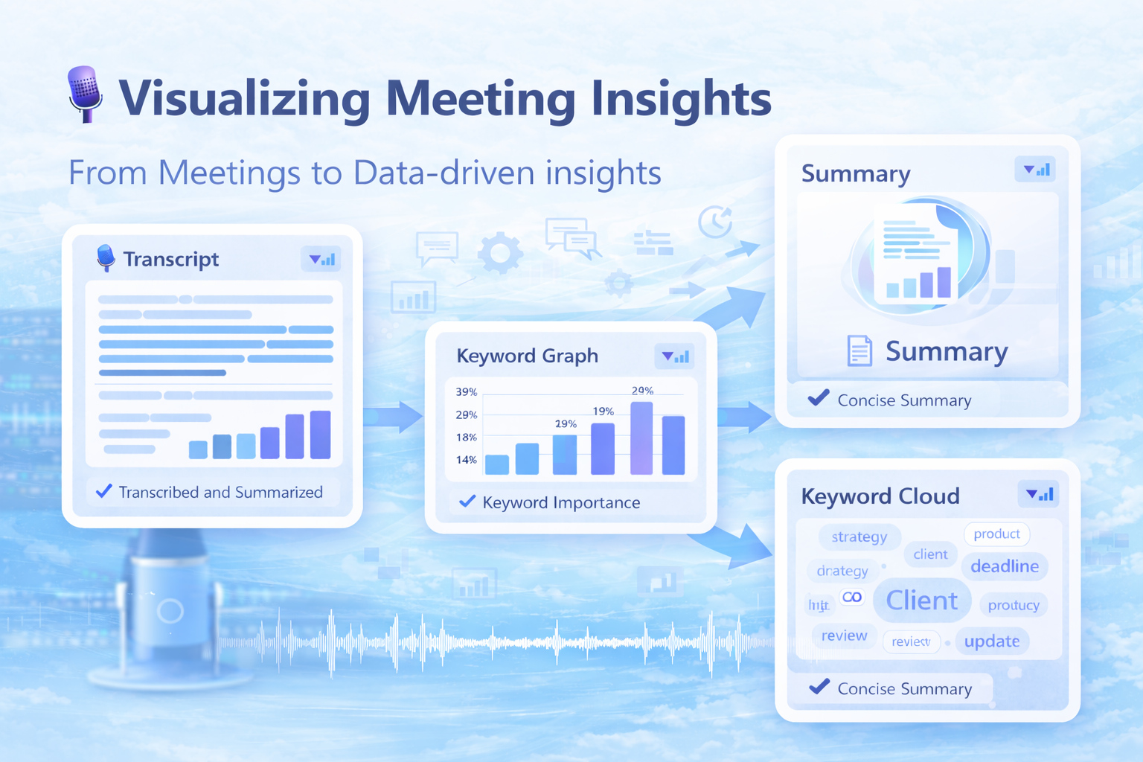

Slide 9
Limitations and challenges faced
Accuracy with Noisy Audio Background noise and overlapping speakers reduced transcription quality.
Segmentation Sensitivity Topic segmentation sometimes split unrelated or very short segments due to inconsistent pacing or vague context.
Performance Bottlenecks Processing large files took longer and occasionally caused UI delays without optimization.
Summarization Balance Creating summaries that were neither too vague nor too detailed was difficult without extensive model fine-tuning.
Frontend + Backend Sync Aligning the UI flow with backend processing stages (especially status updates) required careful asynchronous handling

Slide 10


Future scope
• Speaker diarization (who said what)
• Multilingual transcription support
• Real-time processing
• Integration with Zoom, MS Teams, or Google Meet
LOOKING AHEAD WITH MEETTEXT
• Every word in a meeting matters
• MeetText turns speech into insight
• Built for clarity, simplicity, and growth

Slide 11
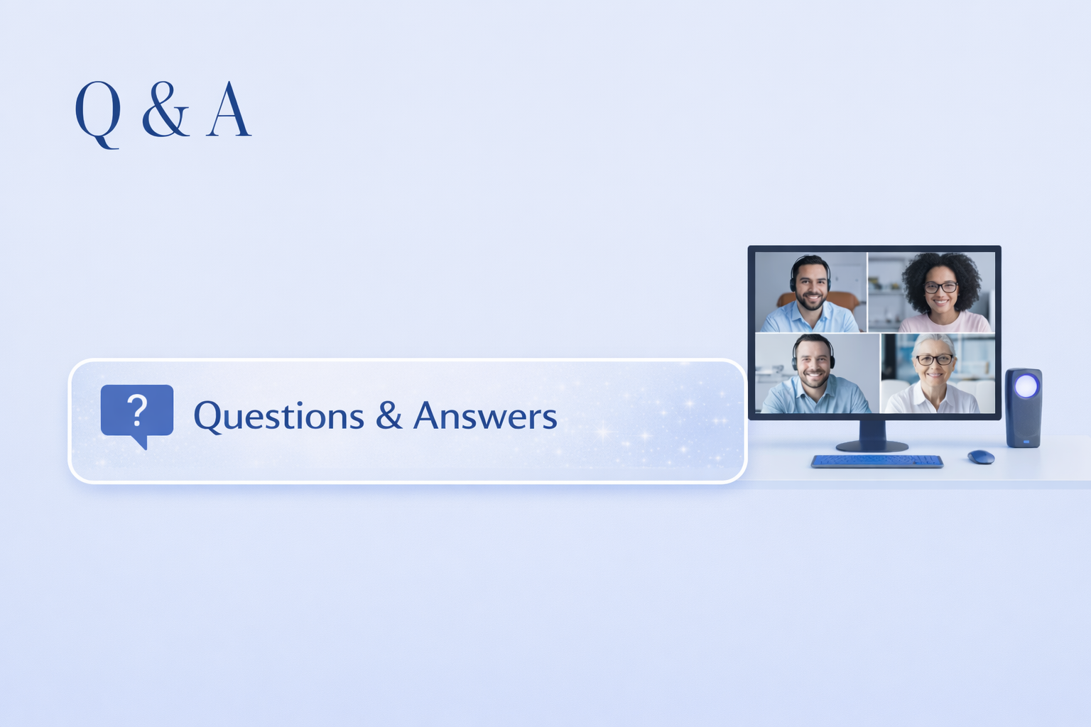

Slide 12
